Slide 1

A
MINOR PROJECT
ON
K8s NODES
SUBMIT BY –
RINKU SHARMA
SUBMIT TO –
ASHISH MITTAL

Slide 2
TABLE OF CONTENT
Introduction to nodes
Types of nodes
Advantages of k8s nodes
Disadvantages of k8s nodes
Some basic command of k8s nodes
Practice of k8s nodes

Slide 3
Introduction to k8s nodes
In Kubernetes (often abbreviated as K8s), a node is a physical or virtual machine that serves as a worker machine in the cluster. It is where containers, which encapsulate the application workloads, are scheduled and run. Each node is responsible for running one or more containers and provides the necessary resources, such as CPU, memory, and storage, to execute those containers.

Slide 4
Types of k8s nodes
Master node-
It is responsible for cluster management.This node is used to configure and manage the resource within the kubenats’s cluster
note:-master node manage the worker nodes
Worker node –
Worker node are the machine responsible for running the containerized application.worker node reports to the master and it is managed by master node

Slide 5
Advantages of k8s nodes
Scalbility
High availability
Resource isolation
Flexibility
Fault tolerance
Node affinity and anti-affinity
Resource management
Monitoring and logging

Slide 6
Disadvantages of k8s nodes
Complexity
Operational overhead
Resource consumption
Cost
Single point failure
Performance implications
Networking challenges
Learning curve

Slide 7
Some basic command of k8s nodes
Kubectl get node
Kubectl describe node
Kubectl describe node node_name
Kubectl top node
Kubectl delete node
Kubectl delete node node_name
Kubectl get no –o yaml
Kubectl get no –o yaml > no.yaml
Kubectl get –show-labels
Kubectl label no node_name label_key=label_value

Slide 8
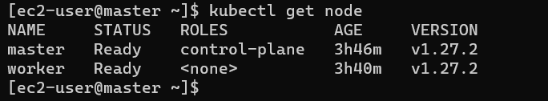
Practice of k8s nodes

Slide 9
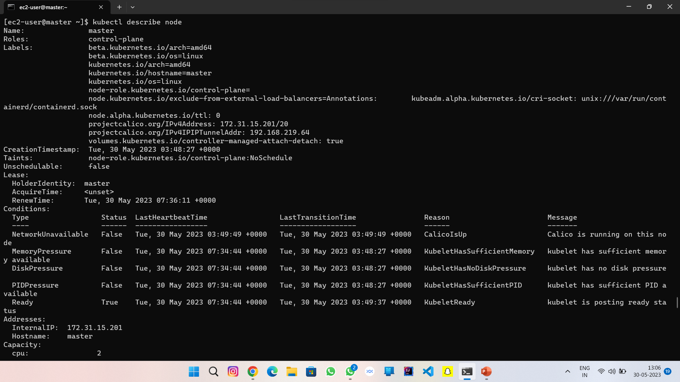

Slide 10
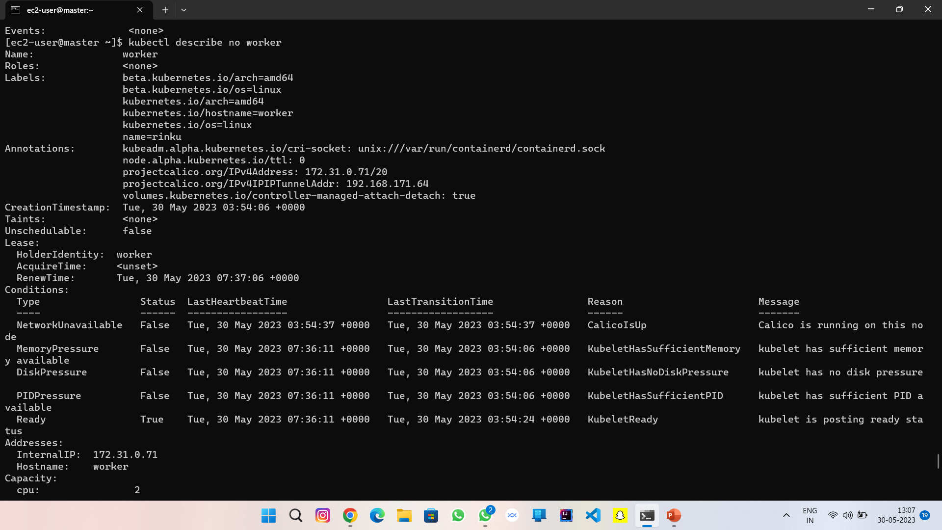

Slide 11
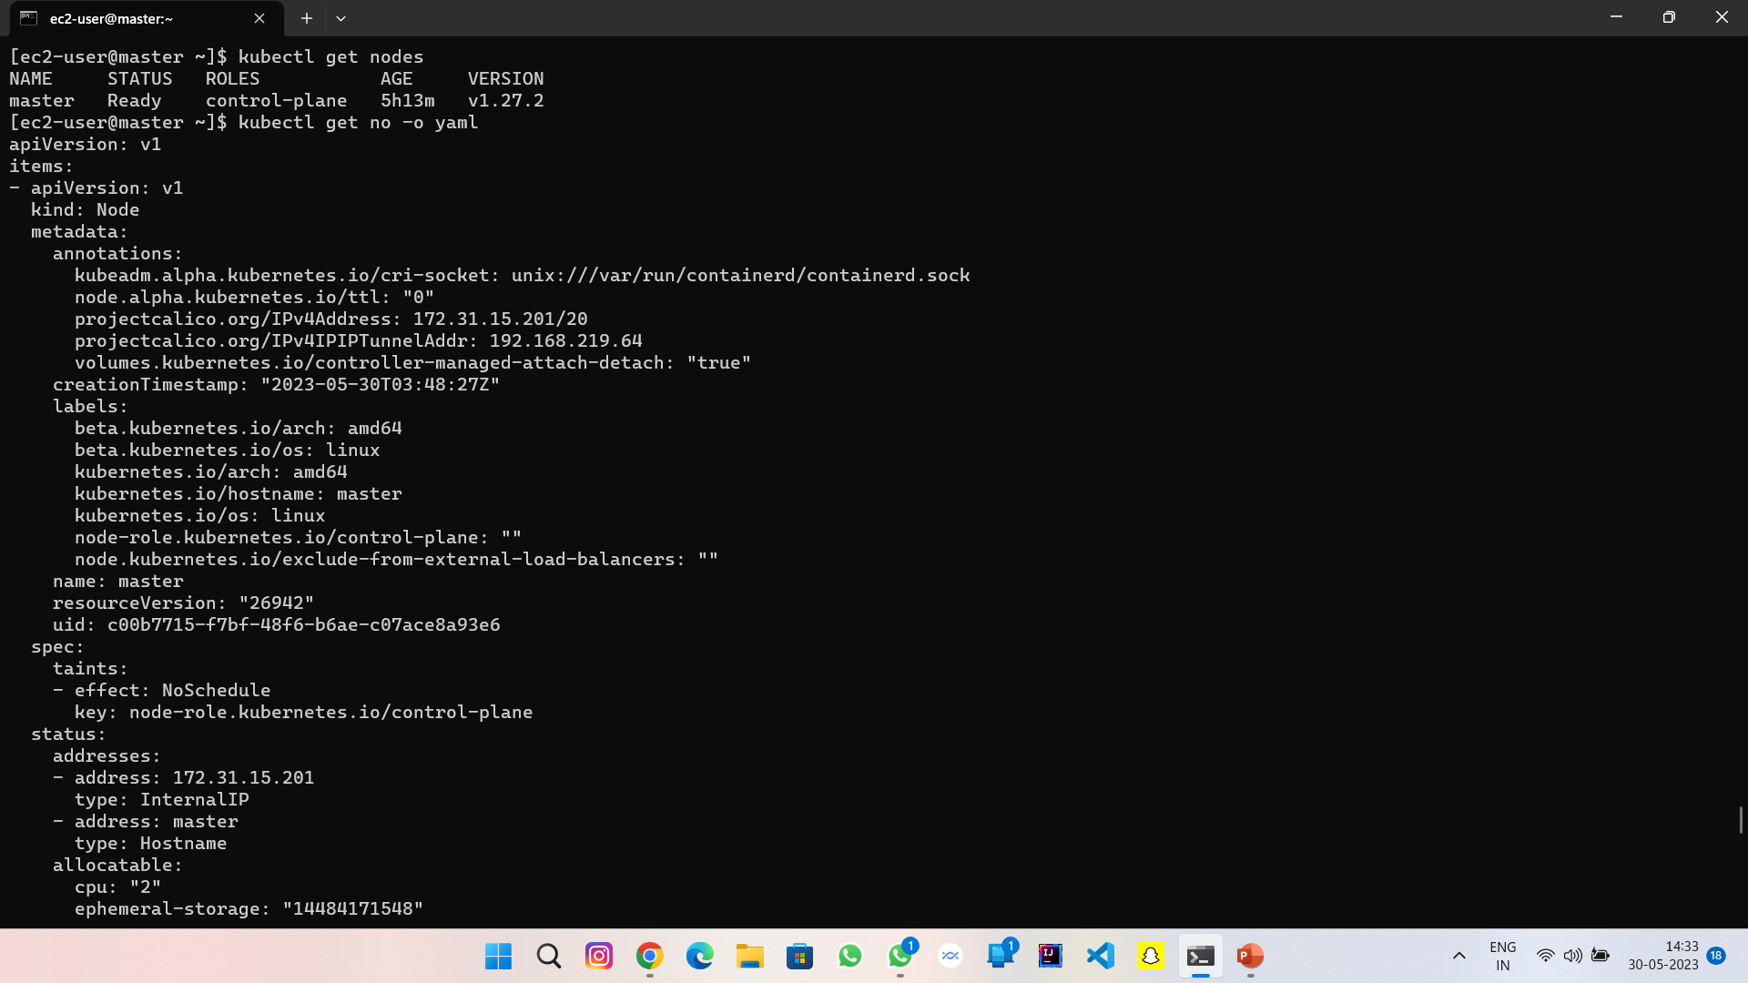

Slide 12
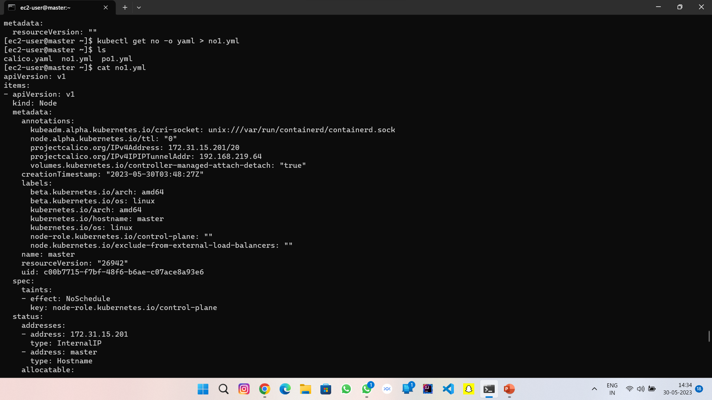

Slide 13
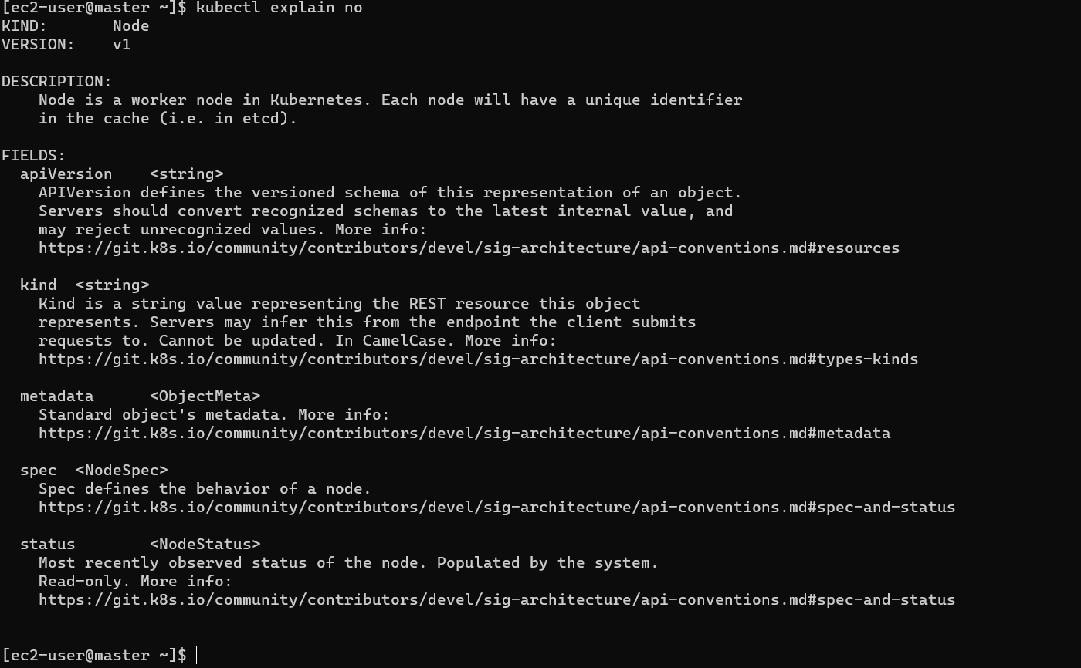

Slide 14
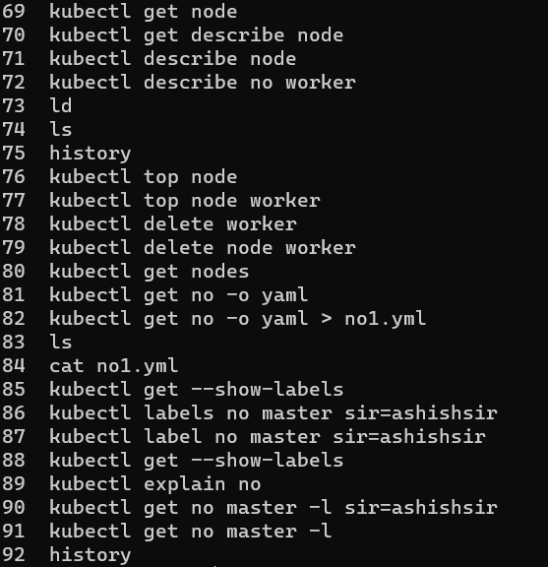

Slide 15


